Slide 1
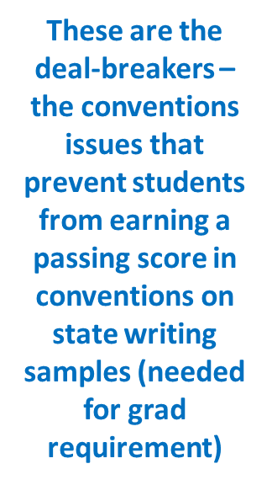
Make sure to holler – I’m happy to help ☺ Do you need a refresher on any of these conventions terms or rules?
Conventions errors to look for (you can pick one or a few instead of all):
Sentences: end where they should with the correct punctuation mark; few if any run-ons, comma splices, or fragments
Spelling: common words correct
Verb tense and point of view: consistent
Any dialogue: punctuated correctly
Capitalization: correct
Punctuation within sentences: sometimes incorrect
Some errors, but few major errors; the most important rules are followed most of the time
Variety: not wide range, but writing is long enough to show solid __th grade skills
I can demonstrate command of standard English conventions when writing
CONVENTIONS SCORE (MTS or INC?) ____

