Slide 1
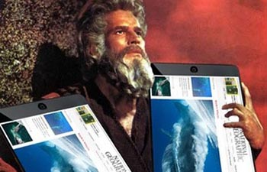
The 10 Chromebook Commandments

Slide 2
No food, drinks or bubblegum in class

Slide 3
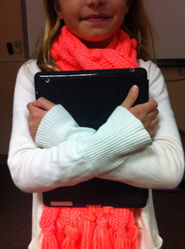
Always carry your Chromebook with
2 hands

Slide 4
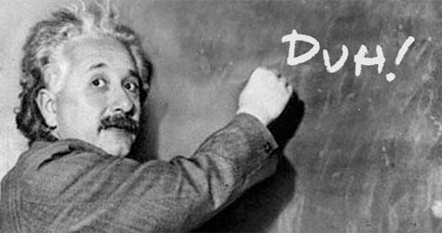
Never throw, toss or swing a chromebook

Slide 5
Only use your own chromebook account

Slide 6
Always Log out/sign out before putting your chromebook away

Slide 7
Only use your assigned chromebook

Slide 8
Wait for your number to get your chromebook

Slide 9
Keep your chromebook muted or use headphones

Slide 10
No social media
Unless you are otherwise instructed by your teacher

Slide 11
Use your Chromebook appropriately

Slide 12
If you don’t have a google docs icon
Open Google Chrome by clicking the icon
It should be on the bottom left
Go to google.com
Click the set of squares in the top right
Click on Drive
Click on Create in the red box on the top left
Click on Documents
Now you should be at step C

